Slide 1

Contact And Networking Project

Slide 2

TEAM NAME : GEEKY NERDS
Team Lead : Yuvansh Joshi
Aditi Sugandhi
Abhisar Grandhi
Ahmed Hussain
Pranay Teja
Priyanshu Naudiyal
Sakshi Bisht
Sai Swetha U
Sinduja R

Slide 3
APPLICATION FEATURES:
USERS:
Search contacts
Search Registered Users
View and Edit Profile Of Contacts
Add, Edit or Delete a contact
CONTACTS:
Contacts can be registered user or non-registered
Contact can be edited by a user
Contact can be deleted by a user

Slide 4
APPLICATION FEATURES:
FRIENDS:
Send friend request
Block a user while a request is sent
Ignore a request
Accept a request
ADMIN:
Can Disable a User if Blocked by more than 3 Users
Can view Summary of registered Users

Slide 5
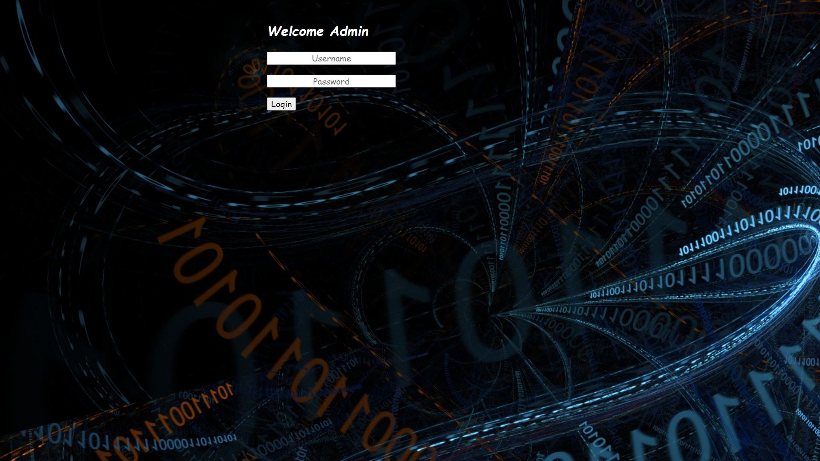
User Login Window

Slide 6
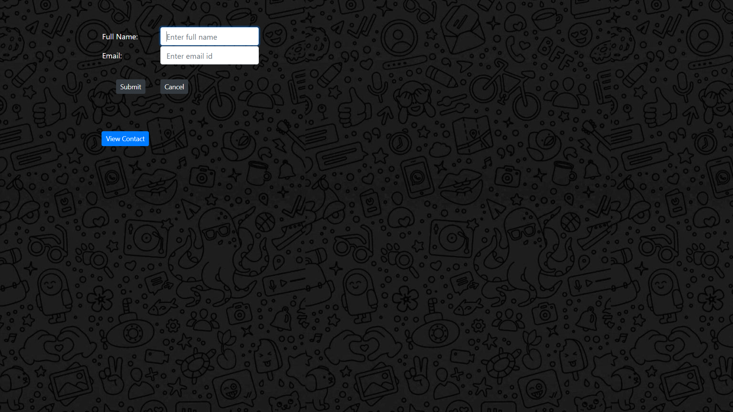
Add User Details

Slide 7
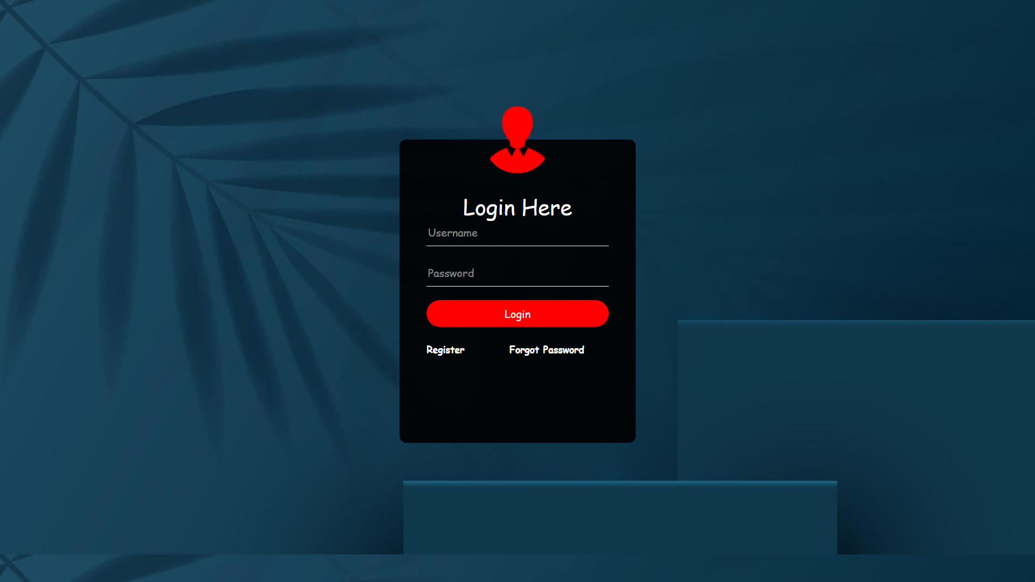
Login Window

Slide 8
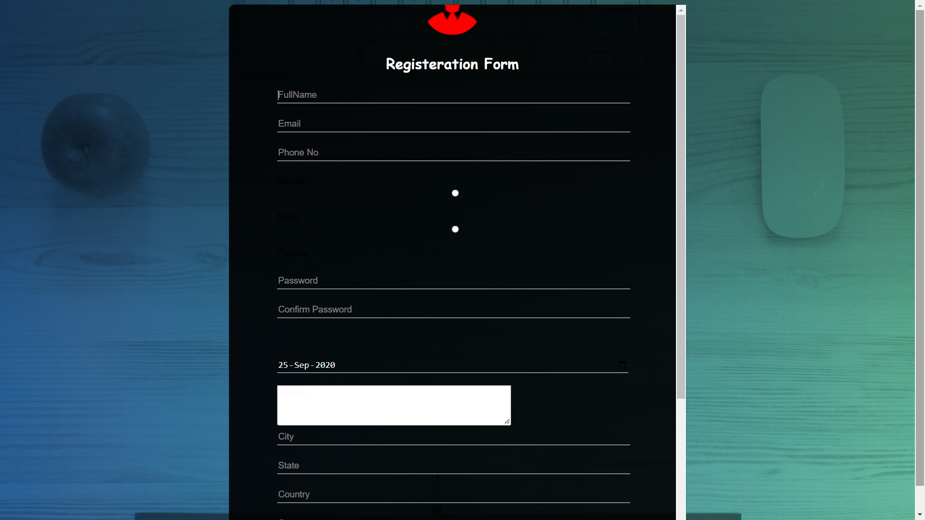
Registration Form

Slide 9
LEARNINGS :
Implementation of MVC layered architecture.
Integration of servlets and JSP to map with various urls.
Designing the UI using HTML, CSS, JS and Bootstrap

Slide 10
LEARNINGS:
Remote Working
Collaborating with colleagues
Various aspects of GIT for sharing individual work with the team
Time Management
In depth knowledge of documentation and naming convention

Slide 11
Thank You!
ANY QUESTIONS?
…
You can find me at:
@username
user@mail.me

